Slide 1

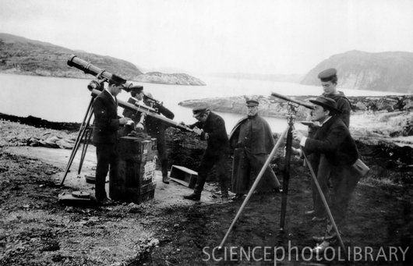


Slide 2
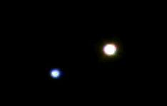
Beta Cygni Through the Telescope

Slide 3
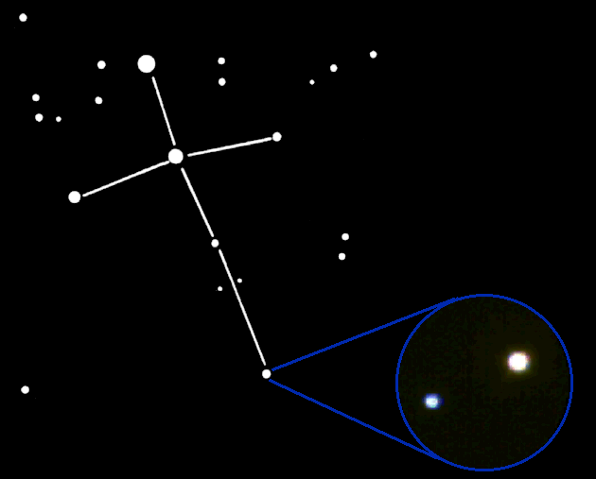
Beta Cygni Through the Telescope
Beta Cygni is in the constellation Cygnus, the Swan.

Slide 4
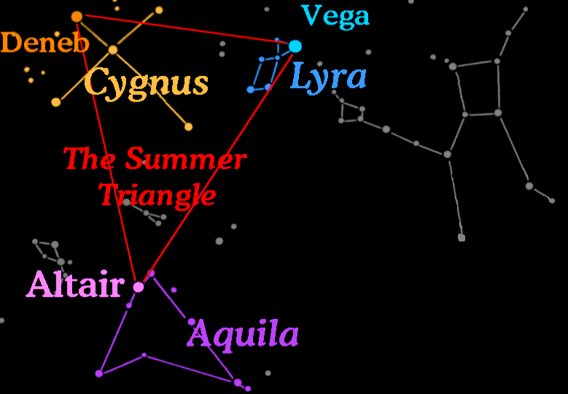
Three bright stars called the "Summer Triangle" can be used to find the constellations Cygnus the Swan, Lyra the Harp, and Aquilla the Eagle.

Slide 5

Star Pairs
Pairs of stars come in two forms:
Optical Double Stars
Binary Stars

Slide 6
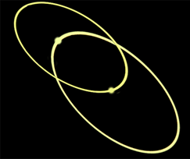

Binary Stars
In a Binary (or Multiple) star system the stars are together in space and in orbit around each other.

Slide 7

Optical Double Stars
Optical double stars are two stars that lie in the same direction when viewed from Earth.
(A side view)
But if you saw them from a different vantage point than Earth, you would see that they are not even close to one another.

Slide 8

Binary or Optical Double …
How do You Tell?
It's all in the distance.
Optical Double stars are very large distances apart.
Binary stars are together in space so they are about the same distance from Earth.

Slide 9
But How Can You Tell How Far Away a Star is?
Earth
Nearby star
ρ
Background stars
Sun
d
ρ
Apparent positions of the nearby star for observations taken 6 months apart.
Photographing a nearby star from different sides of our orbit makes it seem to shift in the sky relative to background stars. This shift, called parallax, can be used to find the distance to nearby stars.

Slide 10
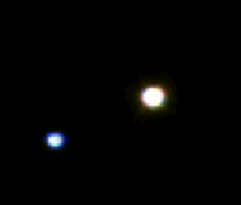
Binary or Optical Double …
25 years ago it was thought that Beta Cygni was a binary star system and that the stars were orbiting each other.

Slide 11
Binary or Optical Double …
We now know that they are nine light years apart and do not orbit each other making this an optical double!

Slide 12
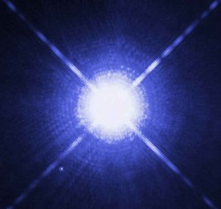
What Makes Stars Shine?
In the 1920's, astronomers were still not yet sure what made stars shine. Some of their ideas were:
Coal.
The constant in-fall of comets and meteors.
The decay of radioactive elements.
Nuclear reactions.
?

Slide 13
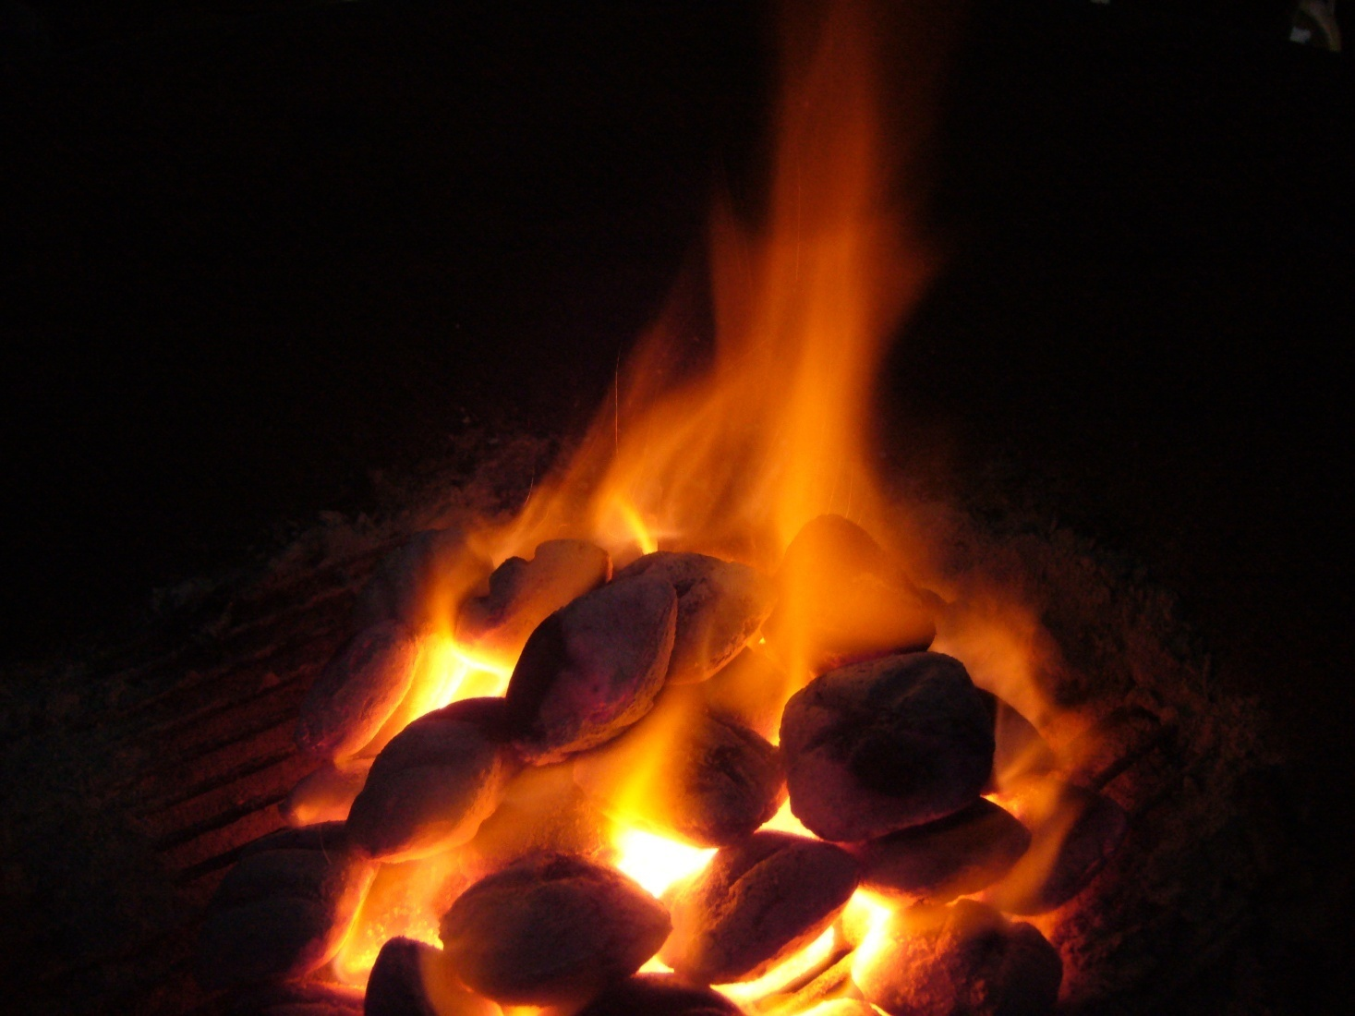
What Makes Stars Shine –
coal?
Coal was immediately dismissed. An object the size of the sun made entirely of coal would only burn for about 10 thousand years and it was known that the Earth was billions of years old.
Wrong!

Slide 14
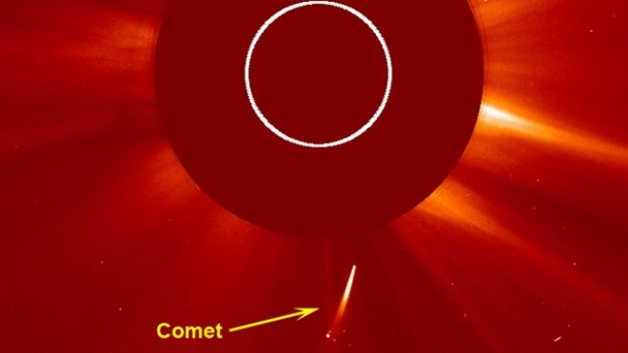
What Makes Stars Shine –
constant in-fall of comets & meteors?
The idea was that as comets and meteors fell into a star they would disintegrate and their matter would be turned into energy.
Wrong!

Slide 15
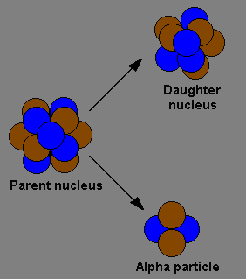
What Makes Stars Shine –
the decay of radioactive elements?
Each star had an assortment of elements which decayed at different rates. It was thought that as one source ran out another would take over.
Wrong!

Slide 16
What Makes Stars Shine?
By the end of the 1920’s astronomers were convinced that the energy to power stars came from the annihilation of atoms …
Nuclear Fission
Large Atom
+ ENERGY
Close but no cigar!
Smaller Atoms
which led to the following (incorrect) conclusion:

Slide 17
What Makes Stars Shine?
  Astronomers thought stars started out large, massive, hot and blue. As they age they gradually shrink to smaller, less massive, cooler white stars, then yellow and finally red dwarf stars.
Size, Mass & Temp.
Wrong!
Age

Slide 18
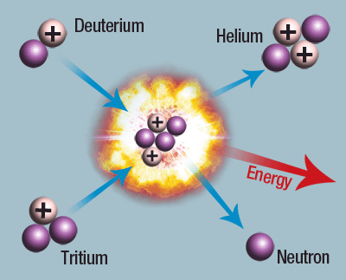
What Makes Stars Shine –
Nuclear Fusion!
Astronomers thought nuclear fusion would only work well for small stars. This idea had trouble gaining acceptance because large stars fueled this way would only last 300 million years or so - much shorter than the Earth’s lifetime.
Correct!

Slide 19
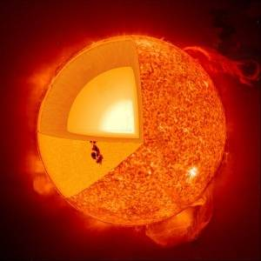
What Makes Stars Shine?
Today it is known that the energy generated by stars comes from nuclear fusion reactions which turn hydrogen into helium with the release of energy.

Slide 20
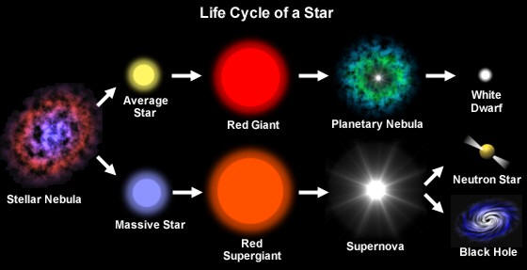
What Makes Stars Shine?
We also know that stars do not start out as blue-white stars and evolve into yellow stars, eventually ending up as red dwarfs.

Slide 21
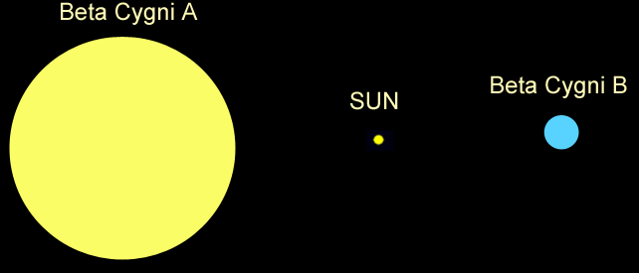
Size Comparison
The yellow star, Beta Cygni A, is 4 times the mass of our Sun, and 20 times larger!
The blue star, Beta Cygni B, is 6 times the mass of our Sun and 3 times the size.

Slide 22
Contrast Double Stars
Beta Cygni is called a 'Contrast Optical Double' because the stars have different colors and properties.

Slide 23
Why Are Stars Different Colors?
Stars form with different amounts of hydrogen. High-mass stars have lots of hydrogen so they burn hotter and faster than stars with less fuel.
So, high-mass stars have different colors, temperatures, and life-spans than low-mass stars.

Slide 24
Contrast Double Stars
Blue stars are more massive and hotter than yellow or red stars. Stars of different masses evolve differently.

Slide 25
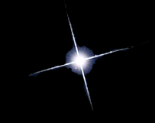

Types of Middle-Aged Stars
Blue stars are
high-mass hot stars.
Yellow stars are similar to our Sun. They are average in mass and temperature.
Red stars are
low mass and cool.

Slide 26
Beta Cygni
The blue star is the hotter of the two, yet the yellow star is the brightest.

Slide 27
How Can a Star be Brighter if it is Cooler?

Slide 28
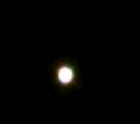
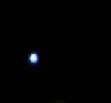
How Can a Star be Brighter if it is Cooler?
Two possibilities:
If it is an Optical Double, the cooler star may be nearer to Earth.
If it is a Multiple star, the cooler star may be larger.

Slide 29
Contrast Optical Double Stars
In this case, the yellow (cooler) star is actually further away than the blue (hotter) star.
So, if the yellow star is brighter, it must be larger.
The yellow star is running out of fuel and beginning to die, so it is turning into a giant.

